Slide 1
Program Development
The creation of software involves four basic activities:
establishing the requirements
creating a design
implementing the code
testing the implementation
These activities are not strictly linear – they overlap and interact

Slide 2
Requirements
Software requirements specify the tasks that a program must accomplish
what to do, not how to do it
Often an initial set of requirements is provided, but they should be critiqued and expanded
It is difficult to establish detailed, unambiguous, and complete requirements
Careful attention to the requirements can save significant time and expense in the overall project

Slide 3
Design
A software design specifies how a program will accomplish its requirements
That is, a software design determines:
how the solution can be broken down into manageable pieces
what each piece will do
An object-oriented design determines which classes and objects are needed, and specifies how they will interact
Low level design details include how individual methods will accomplish their tasks

Slide 4
Implementation
Implementation is the process of translating a design into source code
Novice programmers often think that writing code is the heart of software development, but actually it should be the least creative step
Almost all important decisions are made during requirements and design stages
Implementation should focus on coding details, including style guidelines and documentation

Slide 5
Testing
Testing attempts to ensure that the program will solve the intended problem under all the constraints specified in the requirements
A program should be thoroughly tested with the goal of finding errors
Debugging is the process of determining the cause of a problem and fixing it
We revisit the details of the testing process later in this chapter

Slide 6
Identifying Classes and Objects
The core activity of object-oriented design is determining the classes and objects that will make up the solution
The classes may be part of a class library, reused from a previous project, or newly written
One way to identify potential classes is to identify the objects discussed in the requirements
Objects are generally nouns, and the services that an object provides are generally verbs

Slide 7
Identifying Classes and Objects
A partial requirements document:
The user must be allowed to specify each product by
its primary characteristics, including its name and
product number. If the bar code does not match the
product, then an error should be generated to the
message window and entered into the error log. The
summary report of all transactions must be structured
as specified in section 7.A.
Of course, not all nouns will correspond to
a class or object in the final solution

Slide 8
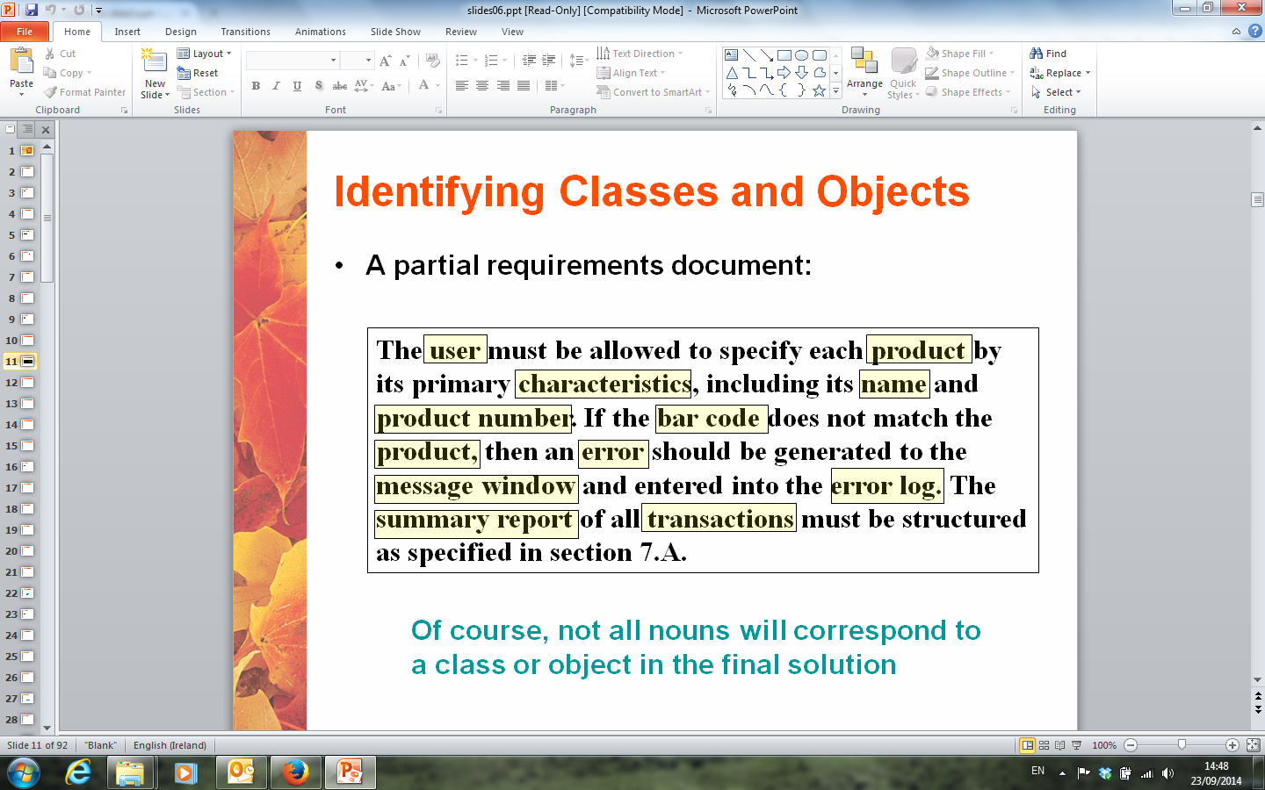

Slide 9
Identifying Classes and Objects
Remember that a class represents a group (classification) of objects with the same behaviors
Generally, classes that represent objects should be given names that are singular nouns
Examples: Coin, Student, Message
A class represents the concept of one such object
We are free to instantiate as many of each object as needed

Slide 10
Identifying Classes and Objects
Sometimes it is challenging to decide whether something should be represented as a class
For example, should an employee's address be represented as a set of instance variables or as an Address object
The more you examine the problem and its details the more clear these issues become
When a class becomes too complex, it often should be decomposed into multiple smaller classes to distribute the responsibilities

Slide 11
Identifying Classes and Objects
We want to define classes with the proper amount of detail
For example, it may be unnecessary to create separate classes for each type of appliance in a house
It may be sufficient to define a more general Appliance class with appropriate instance data
It all depends on the details of the problem being solved

Slide 12
Identifying Classes and Objects
Part of identifying the classes we need is the process of assigning responsibilities to each class
Every activity that a program must accomplish must be represented by one or more methods in one or more classes
We generally use verbs for the names of methods
In early stages it is not necessary to determine every method of every class – begin with primary responsibilities and evolve the design

Slide 13
Static Class Members
Recall that a static method is one that can be invoked through its class name
For example, the methods of the Math class are static:
result = Math.sqrt(25)
Variables can be static as well
Determining if a method or variable should be static is an important design decision

Slide 14
The static Modifier
We declare static methods and variables using the static modifier
It associates the method or variable with the class rather than with an object of that class
Static methods are sometimes called class methods and static variables are sometimes called class variables
Let's carefully consider the implications of each

Slide 15
Static Variables
Normally, each object has its own data space, but if a variable is declared as static, only one copy of the variable exists
private static float price;
Memory space for a static variable is created when the class is first referenced
All objects instantiated from the class share its static variables
Changing the value of a static variable in one object changes it for all others

Slide 16
Static Methods
class Helper
{
public static int cube (int num)
{
return num * num * num;
}
}
Because it is declared as static, the method
can be invoked as
value = Helper.cube(5);

Slide 17
Static Class Members
The order of the modifiers can be interchanged, but by convention visibility modifiers come first
Recall that the main method is static – it is invoked by the Java interpreter without creating an object
Static methods cannot reference instance variables because instance variables don't exist until an object exists
However, a static method can reference static variables or local variables

Slide 18
Static Class Members
Static methods and static variables often work together
The following example keeps track of how many Slogan objects have been created using a static variable, and makes that information available using a static method
See SloganCounter.java
See Slogan.java

Slide 19
Class Relationships
Classes in a software system can have various types of relationships to each other
Three of the most common relationships:
Dependency: A uses B
Aggregation: A has-a B
Inheritance: A is-a B
Let's discuss dependency and aggregation further
Inheritance is discussed in detail later

Slide 20
Dependency
A dependency exists when one class relies on another in some way, usually by invoking the methods of the other
We've seen dependencies in many previous examples
We don't want numerous or complex dependencies among classes
Nor do we want complex classes that don't depend on others
A good design strikes the right balance

Slide 21
Dependency
Some dependencies occur between objects of the same class
A method of the class may accept an object of the same class as a parameter
For example, the concat method of the String class takes as a parameter another String object
str3 = str1.concat(str2);
This drives home the idea that the service is being requested from a particular object

Slide 22
Dependency
The following example defines a class called IntegerSet to represent an integer set
An iteger set can be represented as an array of boolean
Some methods of the IntegerSet class accept another IntegerSet object as a parameter
See IntegerSet.java
See IntegerTester.java

Slide 23
Aggregation
An aggregate is an object that is made up of other objects
Therefore aggregation is a has-a relationship
A car has a chassis
In software, an aggregate object contains references to other objects as instance data
The aggregate object is defined in part by the objects that make it up
This is a special kind of dependency – the aggregate usually relies on the objects that compose it

Slide 24
Aggregation
In the following example, a Student object is composed, in part, of Address objects
A student has an address (in fact each student has two addresses)
See StudentBody.java
See Student.java
See Address.java
An aggregation association is shown in a UML class diagram using an open diamond at the aggregate end

Slide 25
Aggregation in UML
StudentBody
Student
- firstName : String
- lastName : String
- homeAddress : Address
- schoolAddress : Address
+ main (args : String[]) : void
+ toString() : String
Address
- streetAddress : String
- city : String
- state : String
- zipCode : long
+ toString() : String

Slide 26
The this Reference
The this reference allows an object to refer to itself
That is, the this reference, used inside a method, refers to the object through which the method is being executed
Suppose the this reference is used in a method called tryMe, which is invoked as follows:
obj1.tryMe();
obj2.tryMe();
In the first invocation, the this reference refers to obj1; in the second it refers to obj2

Slide 27
The this reference
The this reference can be used to distinguish the instance variables of a class from corresponding method parameters with the same names
The constructor of the Account class (from Chapter 4) could have been written as follows:
public Account (Sring name, long acctNumber,
double balance)
{
this.name = name;
this.acctNumber = acctNumber;
this.balance = balance;
}

Slide 28
Method Design
As we've discussed, high-level design issues include:
identifying primary classes and objects
assigning primary responsibilities
After establishing high-level design issues, its important to address low-level issues such as the design of key methods
For some methods, careful planning is needed to make sure they contribute to an efficient and elegant system design

Slide 29
Method Design
An algorithm is a step-by-step process for solving a problem
Examples: a recipe, travel directions
Every method implements an algorithm that determines how the method accomplishes its goals
An algorithm may be expressed in pseudocode, a mixture of code statements and English that communicate the steps to take

Slide 30
Method Decomposition
A method should be relatively small, so that it can be understood as a single entity
A potentially large method should be decomposed into several smaller methods as needed for clarity
A public service method of an object may call one or more private support methods to help it accomplish its goal
Support methods might call other support methods if appropriate

Slide 31
Method Decomposition
Let's look at an example that requires method decomposition – translating English into Pig Latin
Pig Latin is a language in which each word is modified by moving the initial sound of the word to the end and adding "ay"
Words that begin with vowels have the "yay" sound added on the end
book
ookbay
table
abletay
item
itemyay
chair
airchay

Slide 32
Method Decomposition
The primary objective (translating a sentence) is too complicated for one method to accomplish
Therefore we look for natural ways to decompose the solution into pieces
Translating a sentence can be decomposed into the process of translating each word
The process of translating a word can be separated into translating words that:
begin with vowels
begin with consonant blends (sh, cr, th, etc.)
begin with single consonants

Slide 33
Method Decomposition
See PigLatin.java
See PigLatinTranslator.java
In a UML class diagram, the visibility of a variable or method can be shown using special characters
Public members are preceded by a plus sign
Private members are preceded by a minus sign

Slide 34
Class Diagram for Pig Latin
PigLatin
+ main (args : String[]) : void
PigLatinTranslator
+ translate (sentence : String) : String
- translateWord (word : String) : String
- beginsWithVowel (word : String) : boolean
- beginsWithBlend (word : String) : boolean

Slide 35
Objects as Parameters
Another important issue related to method design involves parameter passing
Parameters in a Java method are passed by value
A copy of the actual parameter (the value passed in) is stored into the formal parameter (in the method header)
Therefore passing parameters is similar to an assignment statement
When an object is passed to a method, the actual parameter and the formal parameter become aliases of each other

Slide 36
Passing Objects to Methods
What a method does with a parameter may or may not have a permanent effect (outside the method)
See ParameterTester.java
See ParameterModifier.java
See Num.java
Note the difference between changing the internal state of an object versus changing which object a reference points to

Slide 37
Method Overloading
Method overloading is the process of giving a single method name multiple definitions
If a method is overloaded, the method name is not sufficient to determine which method is being called
The signature of each overloaded method must be unique
The signature includes the number, type, and order of the parameters

Slide 38
Method Overloading
The compiler determines which method is being invoked by analyzing the parameters
float tryMe(int x)
{
return x + .375;
}
Invocation
result = tryMe(25, 4.32)
float tryMe(int x, float y)
{
return x*y;
}

Slide 39
Method Overloading
The println method is overloaded:
println (String s)
println (int i)
println (double d)
and so on...
The following lines invoke different versions of the println method:
System.out.println ("The total is:");
System.out.println (total);

Slide 40
Overloading Methods
The return type of the method is not part of the signature
That is, overloaded methods cannot differ only by their return type
Constructors can be overloaded
Overloaded constructors provide multiple ways to initialize a new object

